Slide 1
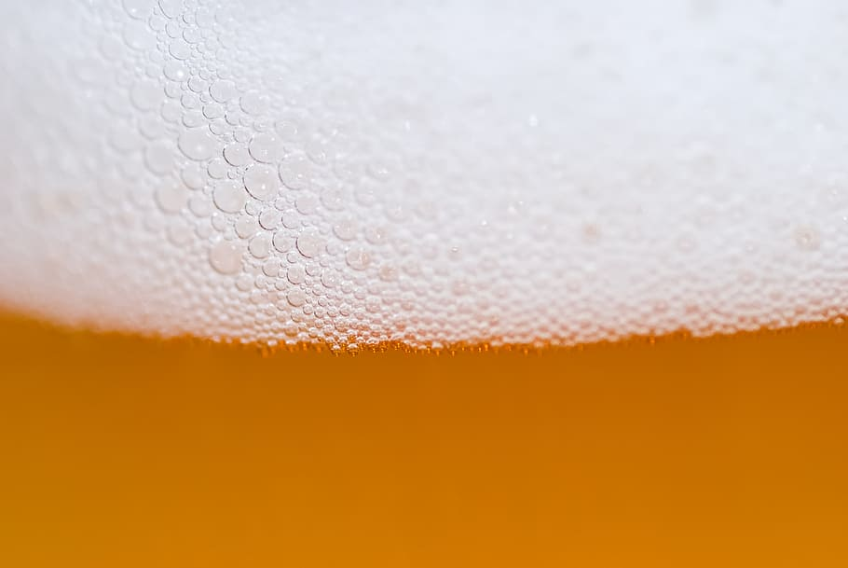


Miranda Morris & Rob Baldoni
AIPI 540
BEER RECOMMENDER

Slide 2
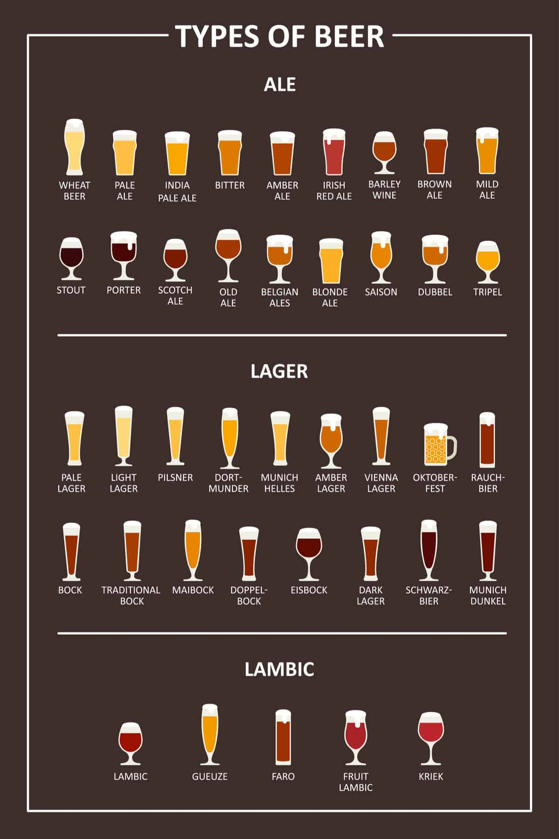
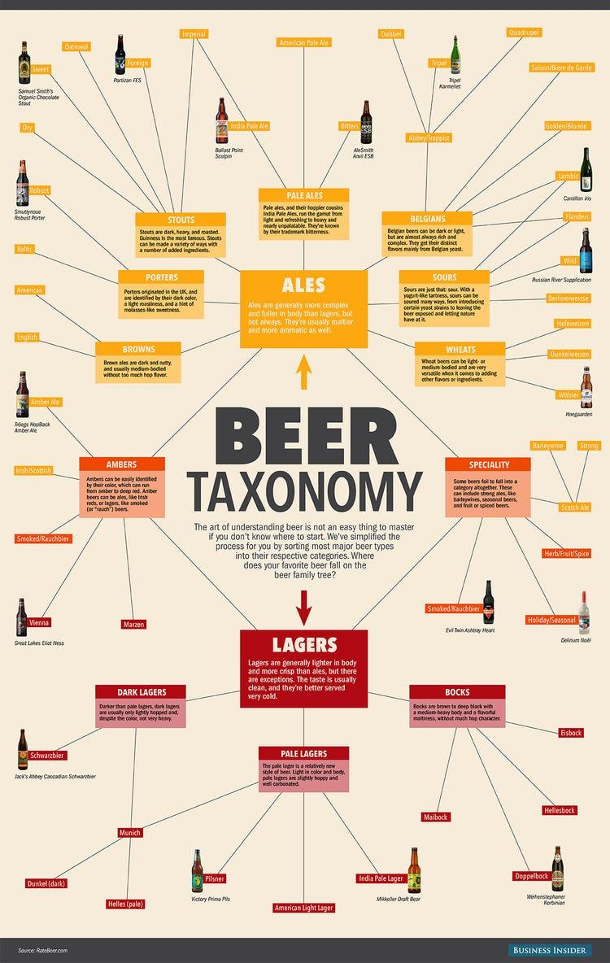
How do we choose a perfect beer?
380+ breweries in NC!
Too many options
Different preferences
Don’t want to spend $$ on beer we don’t end up liking

Slide 3
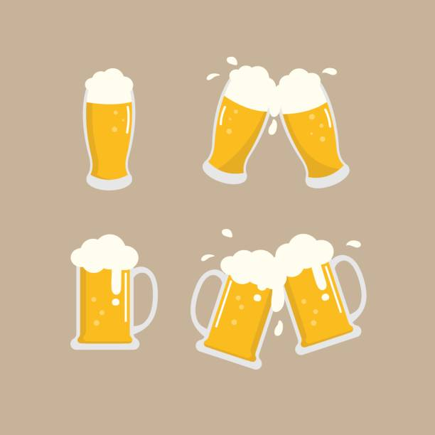
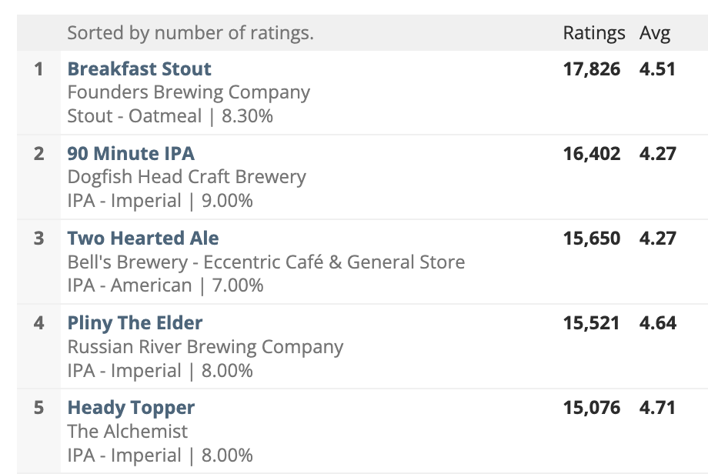

Dataset
Ratings for 5 Aspects:
Appearance
Aroma
Palate
Taste
Overall impression
Beer Advocate
>10 years of data
~1.5 million reviews
Reviews
Product and user info
Ratings for 5 aspects
Plaintext review

Slide 4
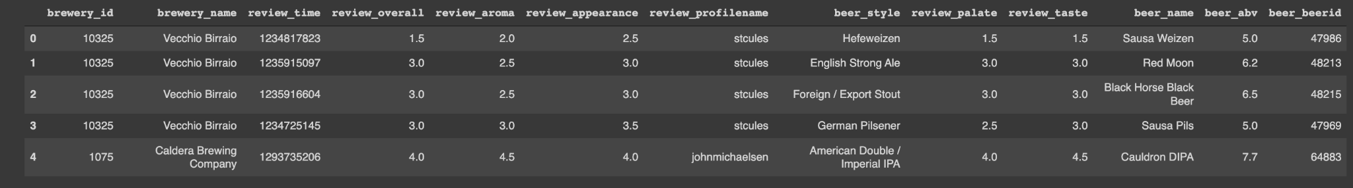
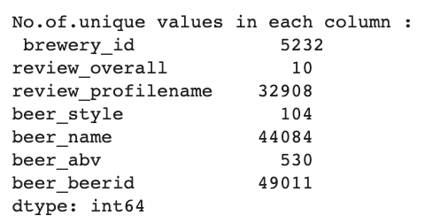
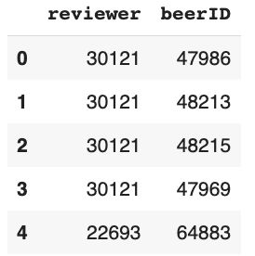
Data

Slide 5
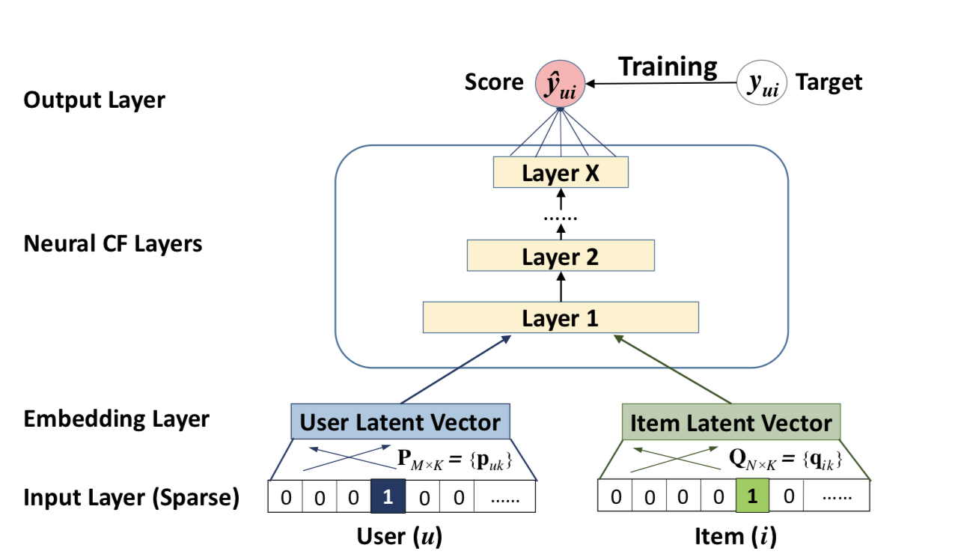
Model for Collaborative Filtering
Notes:
We create an "embedding" for each user and for each item. We can choose the dimensionality of the embeddings we create, which helps us control the complexity of the model. These embeddings are then learned for each user and item during the training process, and they ultimately are able to represent the values of the latent factors learned. we concatenate the user and item embeddings together and feed them through a shallow neural network to generate a predicted rating for each user-item pair

Slide 6
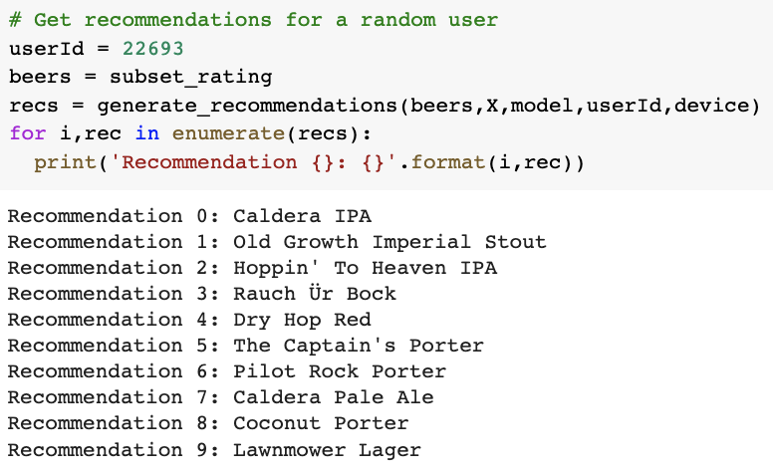
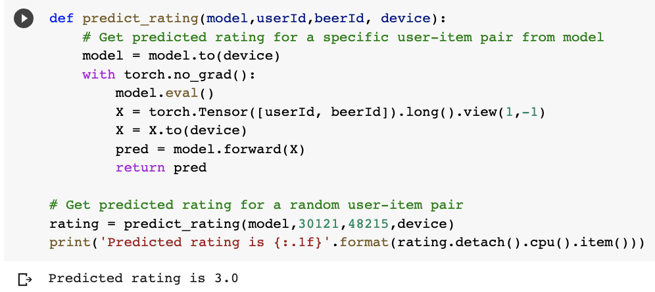
Results

Slide 7

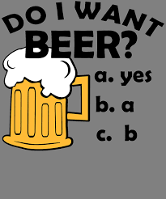

Future Applications
Embedding all aspects and ranking by priority with different weights (i.e., if taste matters more than appearance)
Hybrid system, allowing user to filter results by location & other features

Slide 8
References
https://data.world/socialmediadata/beeradvocate
https://www.beeradvocate.com/
https://ncbeer.org/consumer/

Slide 9
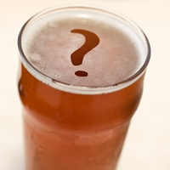
Thank you! Questions?
Miranda’s unsolicited recs for Durham beer:
Glass Jug
Durty Bull
Beer Study
Namu
Boxcar
Miranda’s unsolicited recs for breweries (vibes):
Ponysaurus
Motorco
Bull McCabe’s
Beer Study
Glass Jug

